Slide 1
IBM Cloud Private Performance and Sizing

Slide 2
ICP Performance Analysis
Performance is analyzed based upon 3 representative application architectures
General performance analysis
Sizing your Deployment
Tuning your Cluster

Slide 3
ICP Performance Analysis
Analyzing Performance with Applications

Slide 4
The Polyglot
We will consider a Polyglot application referred to as Acme Air.
This application utilizes multiple programming frameworks.
The intent is to use a general case to evaluate performance and scalability of IBM Cloud Private.
Notes:
Internally developed
Multiple programming frameworks with the different services
This is a good example of a cloud native application and how it would be built
With representation from Java, Node, Spring, Go, …

Slide 5
Online Banking
A second more complicated application is used to simulate Online Banking
Simulation of retail online banking (UI, security and services)
Traffic is encrypted and users are authenticated
Backend services interaction has been simulated via Stub Application
Account Summary Page is developed using Angular JS
Notes:
This example is pulled from an actual production application from a Bank in Canada
Covers aspects of banking, UI, security and even simulates a mainframe backend

Slide 6
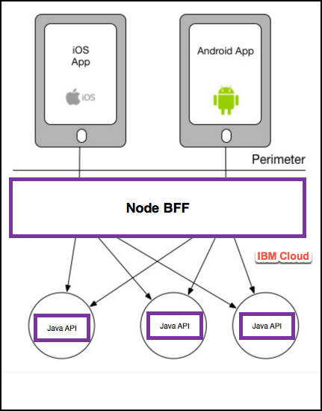
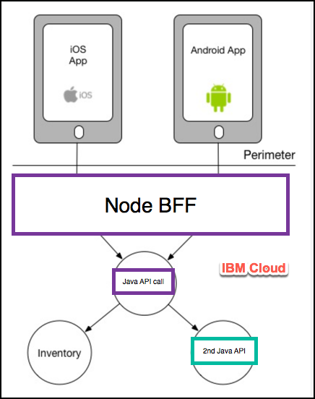
Healthcare Microservices
Typical Microservices application
Architecture comparing 2 and 3 levels
Notes:
We took a few examples from a real healthcare provider
BFF pattern with 2 level and 3 level microservices
This will help us determine if we have problems with say the network layer or backend layer within the platform

Slide 7
Online Banking Performance on ICP
This type of Java microservice application scales nearly linearly
Scaling this application, you have massive parallel workload coming in
The runtime (in this case Liberty) must have enough executable threads to manage
Cannot get full use of ICP resources without tuning
Able to saturate by increasing executable threads
The default (orange) line shows only using horizontal scaling does not fully leverage the cluster resources
Understanding the application and its run time shows increasing the Liberty executor thread pool size is crucial for this Java application
Notes:
Java microservices application
By default we can see that it is not scaling (orange line) we have increased the number of instances of the service without much success
From within Liberty we increase the executable threads and you can see we have some success by uppping to 100 current executable threads
But then do even better with 200.
This isn’t a lesson on executable threads only, but more depending on the application we have to do some research and tuning based upon our
Workload. In this case we are tuning a parameter with Liberty that is supposedly autonomic already.

Slide 8
Healthcare Application Performance on ICP
Comparison of 2 and 3 level BFF service calls
We desire 3 level BFF microservices
Many platforms suffer massive latency when making the jump from 2 level to 3 level
The results of this testing shows only an approximate 10% difference when moving from 2 to 3 layers on ICP
Notes:
We can use this comparison of 2 and 3 level services to show the inherent network efficiency of IBM Cloud Private
In some platforms we may see significant latency due to the multiple network layers

Slide 9
Healthcare Application Performance on ICP Long-Tail Latency
Statistically speaking, the long tail of distributions is the portion of the distribution having a large number of instances or occurrences far from the head (mode or median) of the distribution.
We can consider long-tail latency manifested in the difference between the 90 and 99 percentiles
Long-Tail latency being high typically results in a negative user experience
It can be a difficult problem to solve
Not uncommon in some instances to see 10X (1000%) difference in this region of a distribution
The test shown here shows 0.45X (45%) for IBM Cloud Private
Notes:
We are talking here about the difference between the 90th and 99th percentile
With microservices we always need to pay attention to long tail latency
If the long tail latency is high we will have bad customer experiences and scalability issues
We consider the 45% jump here to be quite manageable and very good

Slide 10
Polyglot Microservices Performance and Scalability on ICP
The test being run in this example is a node.js application accessing a MongoDB data service
We are comparing ”No” and ”Auto” scaling on the node.js service
The services here are deployed within the same cluster
The inability of the application to scale (green line) shows the overall degradation that can occur
These principles still apply as we consider locating the MongoDB externally to the cluster
Notes:
Each of the services are integrated to a specific MongoDB instance
We try three scenarios: on-prem for MongoDB (but not in our cluster), Compose public MongoDB, finally MongoDB in a pod using our Helm chart
Our green line shows no autoscaling and we reach the knee of the curve very quickly … about 18 concurrent users (4500 requests per second) at this point latency increases and throughput comes down. The problem here is because the customer service is a node.js service and is single threaded and becomes our bottleneck.
The orange bar shows how we can autoscale … increase concurrent user requests without increasing the latency

Slide 11
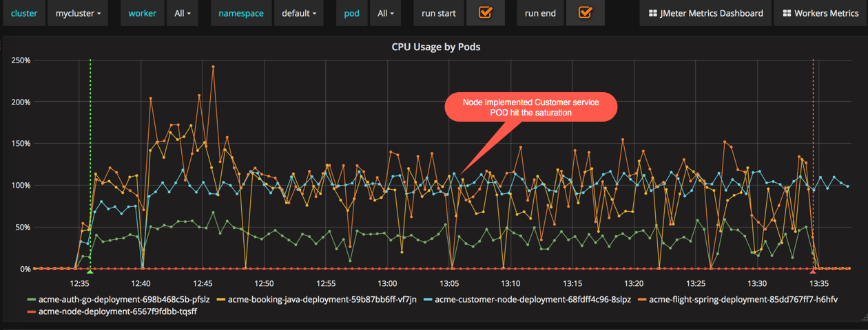
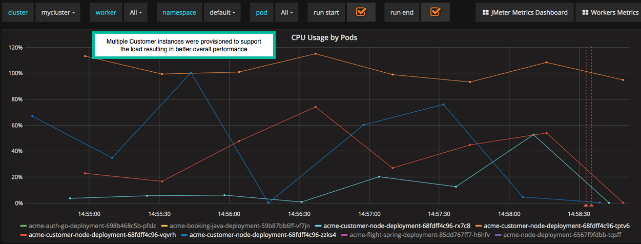
Importance of POD Auto-Scaling on Application Performance
The top chart shows no pod auto-scaling and the bottom chart is with auto-scaling
Top Chart: Blue line shows a pod where the customer service is deployed
Top Chart: Performance is for the most part pegged and demonstrates typical node.js behavior
Top Chart: Unable to push beyond ~100 threads
Bottom Chart: Much better performance as the app scales to match demand
Notes:
Using our Grafana dashboard we get some better insights.
The blue bar in the top graph shows our single node pod basically pegs at 100 percent while in the bottom graph with autoscaling we spawn up services allowing out pod to run at or below 80% indefinitely

Slide 12
Compare On Premise v. Public Data Service
Both workloads are shown using auto-scaling
Shows the impact of network latency introduced with the public data service (Compose MongoDB)
We see linear scaling in the public scenario with lower performance throughout as compared to the on premise configuration
Notes:
Now we look at on premise data service vs. public data service with Compose MongoDB
We know of course we will have some network latency with the public service … no surprise here
Blue here on prem orange public
We get the expected linear scaling out of our public service (since latency keeps us from saturating the cluster with fewer users)
Again no surprises

Slide 13
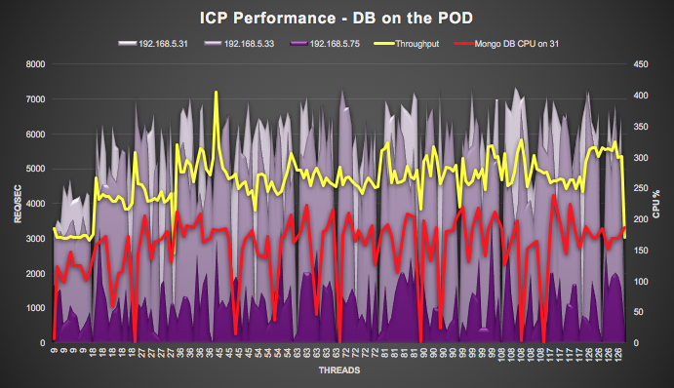
ICP Performance: MongoDB on ICP Cluster
Consider polyglot microservices with MongoDB deployed via Helm locally into the same cluster
Placement of the DB is crucial for scalability of the overall application
The Yellow line shows the throughput of the polyglot application as load is increased
The Red line shows the associated MongoDB pod CPU activity
The remaining (purple) represents the 3 worker nodes in this cluster (saturates at ~400% CPU)
Maximum performance would occur by separating the workload for MongoDB
Notes:
No we put Mongo and our microservice all together on the same cluster
We are seeing how the the node.js and the MongoDB are competing for the same resources concurrently on our nodes
We would obviously like to separate these workloads into separate clusters or…. At minimum different worker nodes

Slide 14
Network Intensive Application Performance on ICP
Consider the moving of a legacy application that is network intensive to IBM Cloud Private
For network intensive virtualized workloads migrating to ICP we may require 1/3 more compute to support the same transaction load (as network resources transition to CPU)
Docker networking overhead is the source for this load
Add an additional 25% capacity for Management / Master nodes and 30% for the running the application
Notes:
We all want to talk about capacity planning and sizing when going from IaaS to K8s
When we have a very light wait but network intensive application ..
Lets ignore the overhead for running a Master / Management / VA nodes, we also see we want to add additional CPU because our network workload is transitioning to CPU. So we spoke earlier about the benefits and low network latency, this is how we pay for it

Slide 15
Java EE Application Performance on ICP
For a Java EE 7 workload migrating from on premise virtualized environment to ICP we require an additional 25% capacity to support similar transaction load (this includes the control plane masters, management, etc.)
This is once again due mostly to Docker networking overhead
Notes:
For the traditional workload we are adding capacity requirement purely for the overhead required by our management plane (nodes)

Slide 16
Cloud Native Application Performance on ICP
For cloud native microservices migrating to ICP from virtualized infrastructure require ~7% additional capacity
Does not include the cluster overhead of ~25% infrastructure increase for the control plane (Master / Management)
Due mostly to Docker networking overhead
Notes:
Now as we mature and move to a cloud native workload we are only looking for an additional 7% requirement for CPU
So why is this? Is it ICP … next slide

Slide 17
Reason for Additional Overhead on ICP
Compare Docker on virtualized infrastructure with virtualized alone
We see overhead from Docker networking
Inefficient handling of software and networking transaction are manifested in higher CPU utilization
This behavior is currently being worked from the platform perspective
Notes:
The reason …. We ran the same workload on VMware with Docker (no K8s / ICP) and On Premise VMware
You an see we are driving the Network CPU (the violet line)
We talked about the 25% increase well ….. 21% was coming from network inefficiencies within Docker (network overhead within Docker)
There is some work to be done we are will continue to watch this and work on it

Slide 18
Sizing Your Deployment
Choosing a Topology

Slide 19
Considering Capacity
To accurately size you ICP cluster you must consider your workload
Are you running any large containers that require large compute / memory footprints?
What type of applications are you running? Are they microservices … which frameworks / runtimes … ?
Do your applications require persistent or external storage? What type of performance is required for this storage? How many instances of persistent volumes of each type are required?
What are the current resource requirements to run your workloads and how are these requirements expected to change?
19
IBM Cloud / © 2018 IBM Corporation

Slide 20
The Sandbox
Assumptions
Resiliency is a secondary consideration
Maximum pod size is small
Small amount of workload
Vulnerability is not a concern
Role | Count | vCPU / Core | Memory (GB) | Storage (GB)
Master, Boot, Management, etcd | 1 | 4 | 8 | 250
Proxy | 1 | 2 | 4 | 140
Worker | 3 | 4 | 8 | 200
NFS | 1 | 2 | 4 | 300

Slide 21
Production Deployment
Assumptions
This is one possible starting point
Storage must be sized as its own exercise
Etcd should be broken out when worker nodes surpass 50
The number and specific size of worker nodes depends heavily on the personality of your workload
Role | Count | vCPU / Core | Memory (GB) | Storage (GB)
Boot | 1 | 4 | 8 | 150
Master | 3 or 5 | 8 | 32 | 300
Etcd | 1 - 3 | 4 | 16 | 150
Management | 2 or 3 | 8 | 32 | 300
Proxy | 3 | 4 | 16 | 250
Vulnerability Advisor | 1 - 3 | 8 | 32 | 500
Worker | 5+ | 8 | 32 | 250
Since sizing best practices change regularly with practes and updates, please see this article for the most current shirt size guidelines https://github.com/ibm-cloud-architecture/refarch-privatecloud/blob/master/Sizing.md
Notes:
We are recommending shirt sizes with broad assumptions of workload. See the article in the link that is continually updated.

Slide 22
Boot Node
Boot Node Considerations
Externalize for deployment of cluster convenience
Externalizing your boot node alleviates some resource constraints during cluster installation
IBM Cloud / © 2018 IBM Corporation

Slide 23
Master Node
Master Node Considerations
At least 3 nodes ensures a quorum can be reached upon failure
Additional nodes help ensure the ability to recovery from failure
Consider minimum recommendations to be applicable to only non-production environments
Can Load Balance masters, but only one is the primary master
Only a single Master Node is active at any time
IBM Cloud / © 2018 IBM Corporation

Slide 24
etcd Node
etcd Node Considerations
Shared with Calico
Scale to meet a larger number of small transactions
Very large clusters will require externalizing etcd to its own node(s)
IBM Cloud / © 2018 IBM Corporation
Notes:
We do not have a lot of field experience and best-practices here
Unless you have a very large cluster (50+ nodes) this is not required at this time

Slide 25
Management Node
Management Node Considerations
Larger clusters with more workload thus require larger management nodes
Fewer large nodes will have the same impact as many small nodes
Your production clusters should use independent management nodes
IBM Cloud / © 2018 IBM Corporation
Notes:
Read the slide
In fact there is no reason not to have only 1 or 2 management nodes in a modest cluster

Slide 26
Proxy Node
Proxy Node Considerations
For compute sizing consider total resource sizing versus the # of nodes
You can tune your ingress controller to your workload
Your proxy VIP will point only to a single node at a time
Consider optionally load balancer to spread workload to your proxy nodes
Understand your workload to tune and size appropriately
IBM Cloud / © 2018 IBM Corporation

Slide 27
Worker Node
Worker Node Considerations
If your cluster has a small amount of workload consider increasing the number of worker nodes while decreasing the size of the nodes (for adequate headspace, efficiency, mobility, resiliency)
If you have large pods your worker nodes should be larger to accommodate workload mobility
Java workloads typically use 4 x CPU for memory
Other application frameworks may be closer to 2 x CPU = Memory
Consider YOUR workload to size your worker nodes
IBM Cloud / © 2018 IBM Corporation

Slide 28
Tuning IBM Cloud Private
Best-Practices for Tuning the Cluster

Slide 29
ICP Tuning: The Impact of ICP Access Logging
Performance is impacted by Proxy logging (comparing blue and orange bars in both graphs)
Network intensive loads show this can accumulate up to 30% additional overhead
The overhead is mostly attributable to ELK stack activity
Notes:
The first thing with tuning is to look at the overhead of logging when talking about high transaction rates
You must look at your environment, assess the impact and in some cases tune down

Slide 30
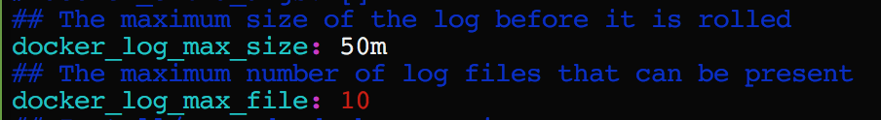
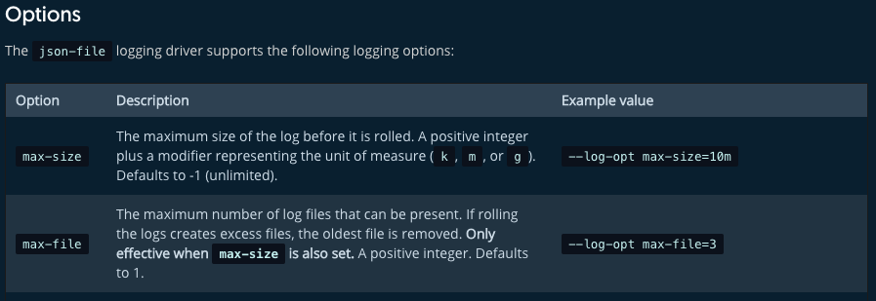
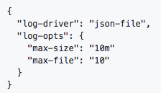
ICP Application Logging
Configure log rotate for Docker (max-size, max-file)
Without log rotate disk may fill and trigger pod eviction (and image garbage collection)
Add install can be configured in config.yaml
If Docker is installed independently
Update Docker services with “—log-opt max-size=10m –log-opt max-file=10”
Add the config to /etc/docker/daemon.json
Notes:
The next thing to consider is the implication of application log
Why for instance do we configure log rotation? If log space fills up we will cause pod eviction.
Update the cluster config yaml file for log rotation as seen here
But the bigger message is to understand if you are evicting pods for purposes that are avoidable
There is no “special sauce” here, you must take the time to understand the behavior of your application pods

Slide 31
Impact of Proxy Size and Upstream Keep Alive
Shows the importance of upstream keep-alive
Proxy node capacity is vital, ensure yours is sufficient
For network intensive workloads, bigger proxy node can be more efficient than multiple smaller proxy nodes
Default keep-alive is 32 – consider tuning this based upon your workload
Note: Keep-alive has been enabled by default since ICP 2.1.0.2
Notes:
Two main takeaways here: Importance of upstream keep-alive … we have this for you since 2102 and this is a bit of chest thumping
Next we must make sure that the proxy node is not providing a bottleneck … do we want one big proxy nodes or multiple smaller proxy nodes / ingress controllers
We actually show that spreading our resources between 3 or 1 or 2 proxies we get the same performance

Slide 32
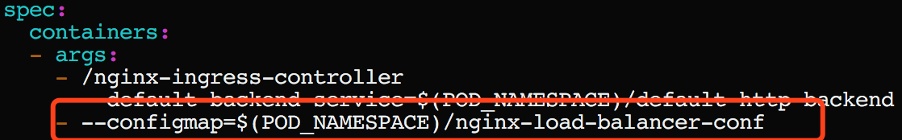
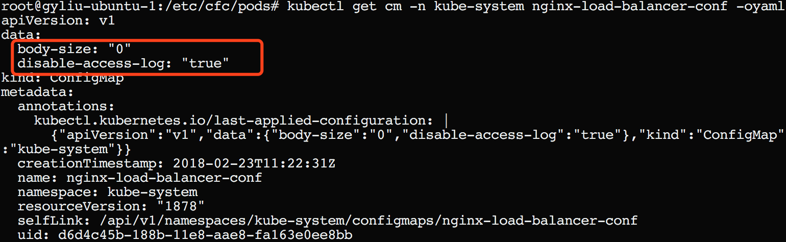
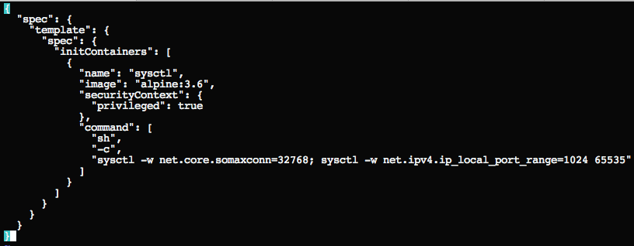
Ingress Parameters
Ingress parameters matter
Check the configmap
Update this configmap for tuning performance
Among the settings to consider for your workload:
Max-worker-connections
Worker-processes
Reference the K8s documentation for detail description: https://github.com/kubernetes/ingress-nginx/blob/master/docs/user-guide/configmap.md
Use initContainer to adjust systctl default values: kubectl patch ds -n kube-system nginx-ingress-lb-amd64 --patch="$(cat patch.json)"
Notes:
This is some tuning parameter guidance on the ingress controller. Here are a few examples. This is public knowledge and not a lot of magic. Hard lesson here is you must understand your workload and use the resources available to you.

Slide 33
Example: Impact of Liberty Autonomic Threading Algorithm
Java applications running on Liberty with default autonomic threading algorithm may see significant performance degradation
Note: Liberty autonomic algorithm was redesigned in 18.0.0.1 showing a 6X improvement
Notes:
We mentioned some instances earlier where we overrode the autonomic capabilities of the Liberty container.
This was a good lesson, but the Liberty team is reacting and has been able to greatly improve the performance of the Java workloads
Deployed on Liberty

Slide 34
IBM Cloud Private Large Topology
Performance in Large Topologies
Notes:
We are getting requests for massive amounts of workload to be served out of ICP clusters and want to make sure we understand how we can support it.

Slide 35
Large Topology Scalability on ICP Clusters Online Banking Application
This example is demonstrated on both 100 and 1000 node cluster
running 50 instances of the application
The microservices workload scales linearly achieving 4.3 billion API calls per day
Notes:
So we took one request and tried to scale it up and we were able to press our cluster to the point where we had 14k concurrent user requests getting to the 4.3Billion requests in a day for the cluster. This was an arbitrary benchmark we achieved with fairly linear performance.

Slide 36
Large Topology Supported Product Limits
ICP Version | Maximum Nodes per Cluster | Total Pods Per Cluster | Pod Spec | Worker Node Spec
2.1.0.1 (Kube 1.8.3) | 300 | 9000 | 0.1 CPU, 100M Memory | 4 Core, 8G Memory
2.1.0.2 (Kube 1.9.1) | 500 | 10000 | 0.5 CPU, 512M Memory | 8 Core, 16G Memory
2.1.0.3 | Target 1000 | Target 20000 | 0.5 CPU, 512M Memory | 8 Core, 16G Memory
The node sizes are representation not a recommendation with larger clusters typically accommodating larger configurations
The 2.1.0.3 values are unproven or unverified as of the time of creating this presentation

Slide 37
IBM v. K8s and Supported Product Limits
Kubernetes claims 5000 nodes why can ICP not?
ICP provides extra enterprise capabilities
ICP uses Calico as default network overlay
ICP Calico uses node-to-node mesh to configure peering between all Calico nodes
Calico load increases etcd load and increases greatly for very large clusters (1000+ nodes) **etcd may be broken out in its own node starting in 2.1.0.3
Node-to-node mesh stops working if there are more than 700 nodes in a cluster
Note: It is recommended to configre route relectors for BGP daemons in all cases starting scales approaching 1000 nodes

Slide 38
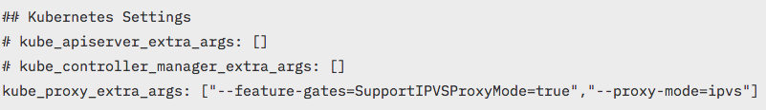
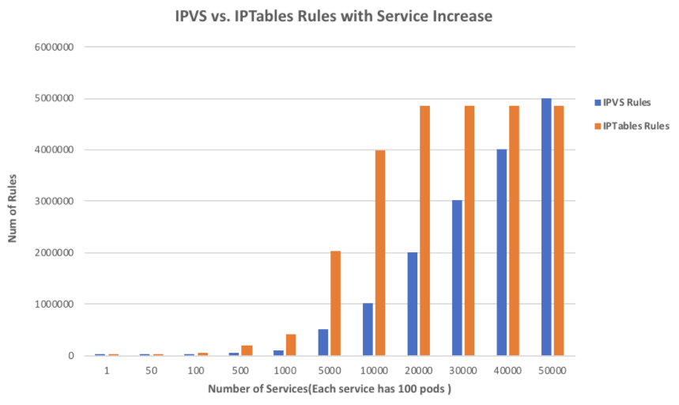
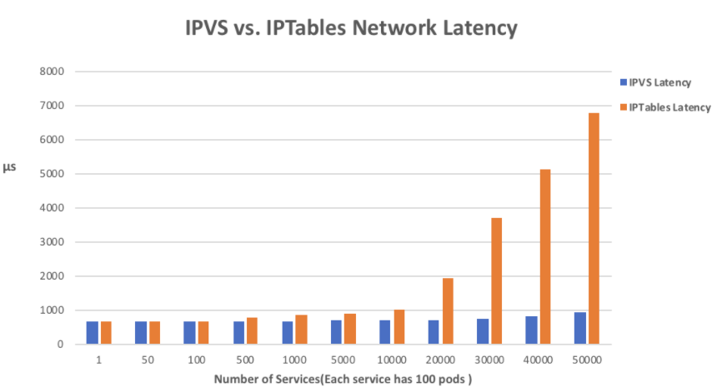
Kube-proxy: IPVS (Beta K8s 1.10, ICP 3.1.0.3)
We have three choices for kube-proxy mode:
namespace, iptables (default), ipvs (beta for 2.1.0.3)
Issues with iptables as a load balancers:
Not incremental: copy all rules, make changes, save back
Locked during update
Time to add one rule when there are 5k services (40k rules): 11 minutes increases to 5 hours for 20k services
Notes:
Why is IPTables performance bad as our cluster grows to a very large topology
Every time a new service is added the whole table on the node is updated … .currently for iptables there is no incremental update
So kube-proxy first lock the rules upgrade the rules then apply the rules …. You can see the benchmark here
5k ervices gives 40k rules and 11minutes to upgrade and it gets worse from there
IPVS in these large cluster shows a great advantage. It may not be time to go to production with IPVS, but probably time to begin evaluating.

Slide 39
In Summary
Consider your workload volumes
Do you have a high number of transactions? Is the workload variable?
Consider your workload personality
Are your services network intensive? What are the programming frameworks you are using?
Consider your performance requirements
How do your applications scale? Horizontal? Vertical? Sharding?
IBM Cloud / © 2018 IBM Corporation
39
Notes:
The real story is we have hopefully provided some insight, but you must do your homework.
Find others in the open community running similar workloads and expand upon their knowledge.
We are here to help and provide assistance… but these decisions and the greatest knowledge will come from within teams like yours.

Slide 40
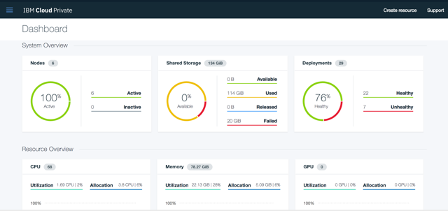
Try IBM Cloud Private today!
Guided and Proof of Technology demos
Free Community Edition!
http://ibm.biz/ICP-DTE
40
40
IBM Cloud / © 2018 IBM Corporation

Slide 41
41

